Slide 1



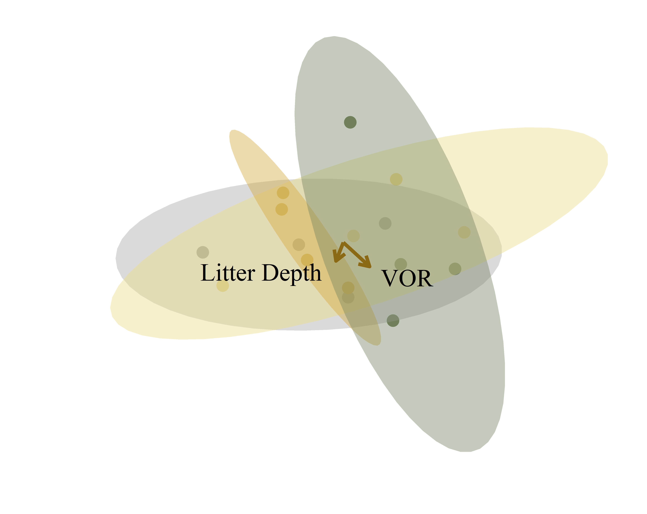
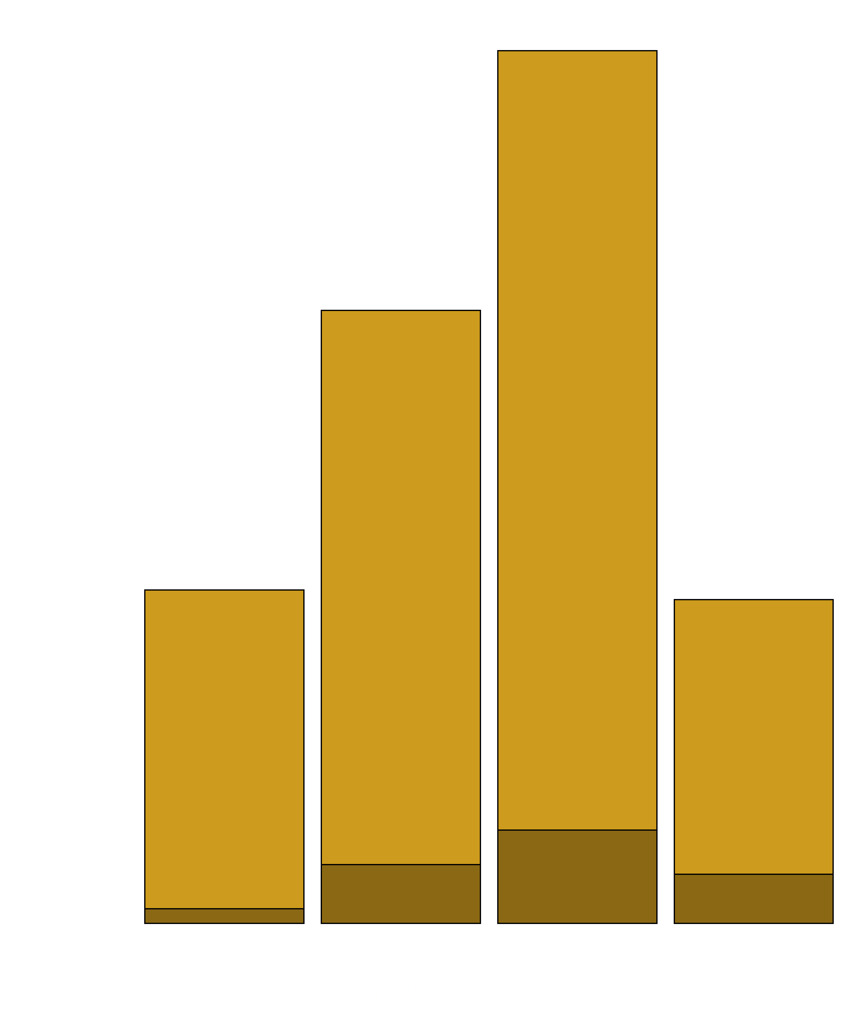
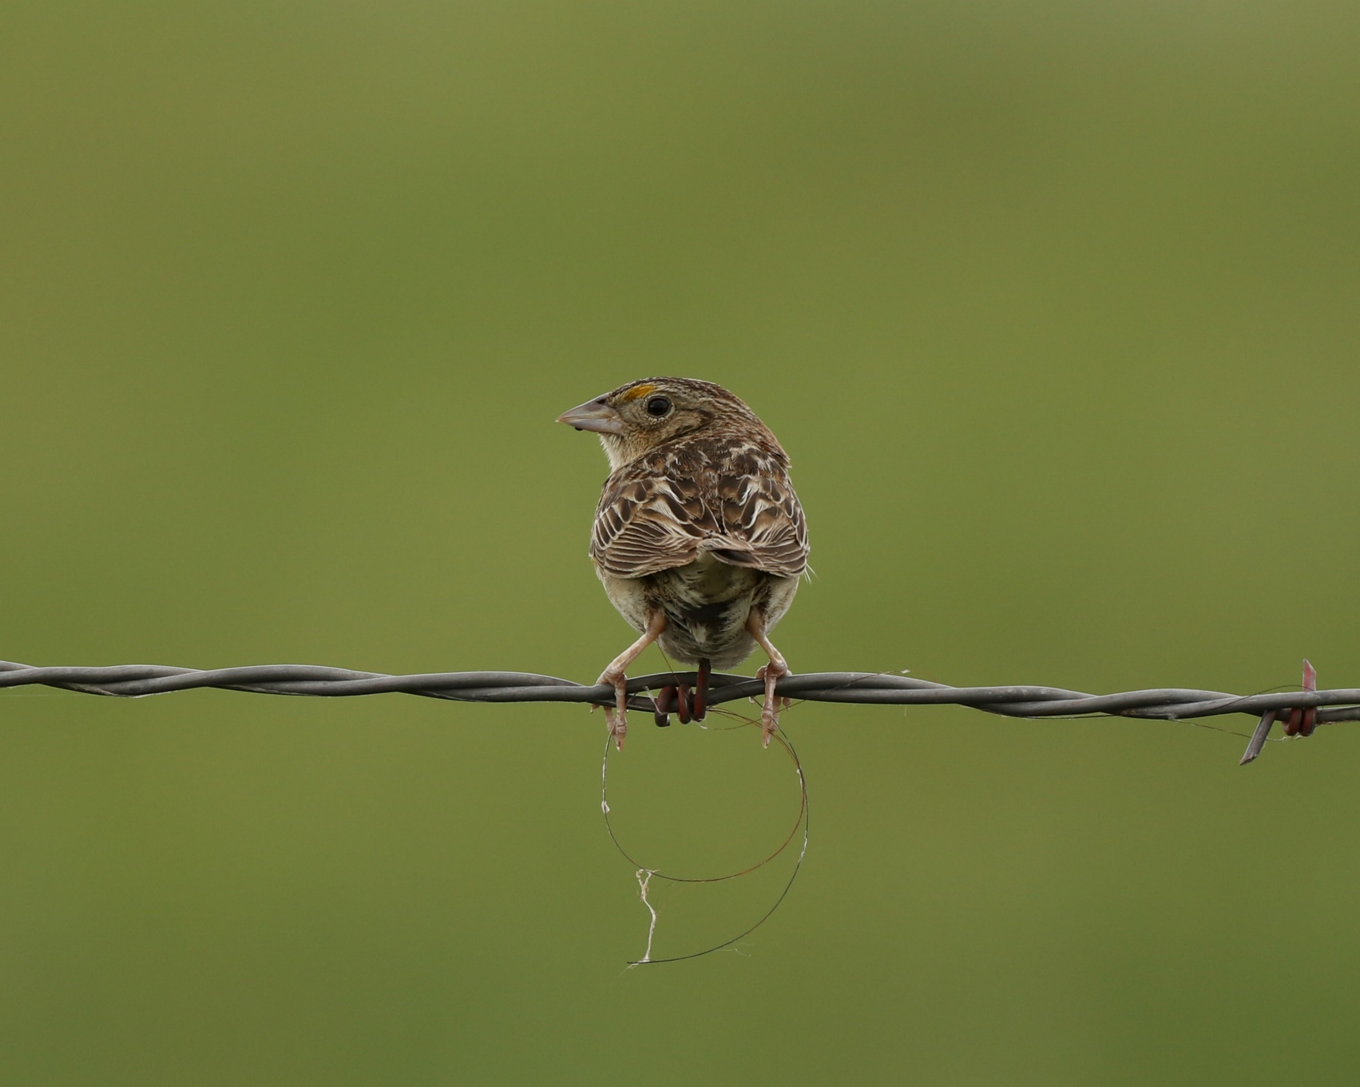
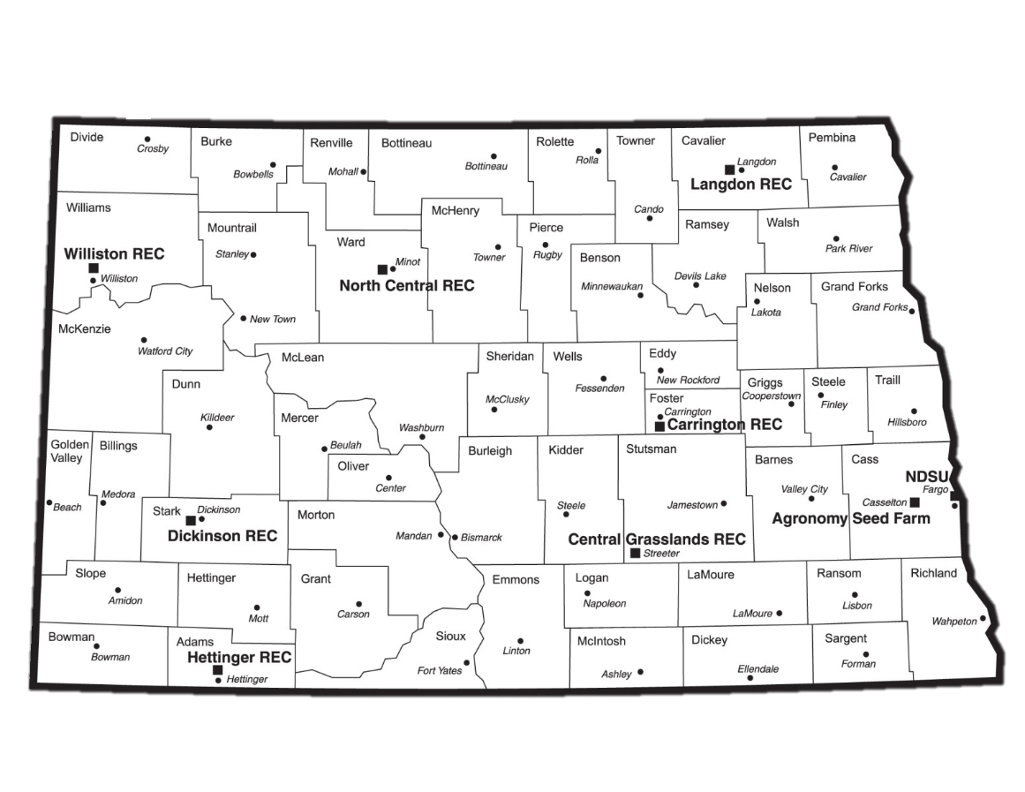
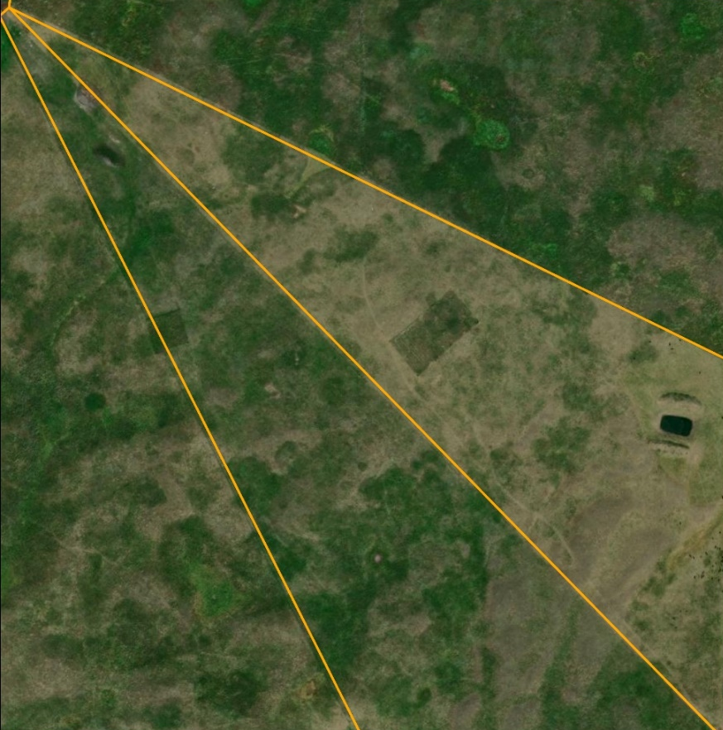
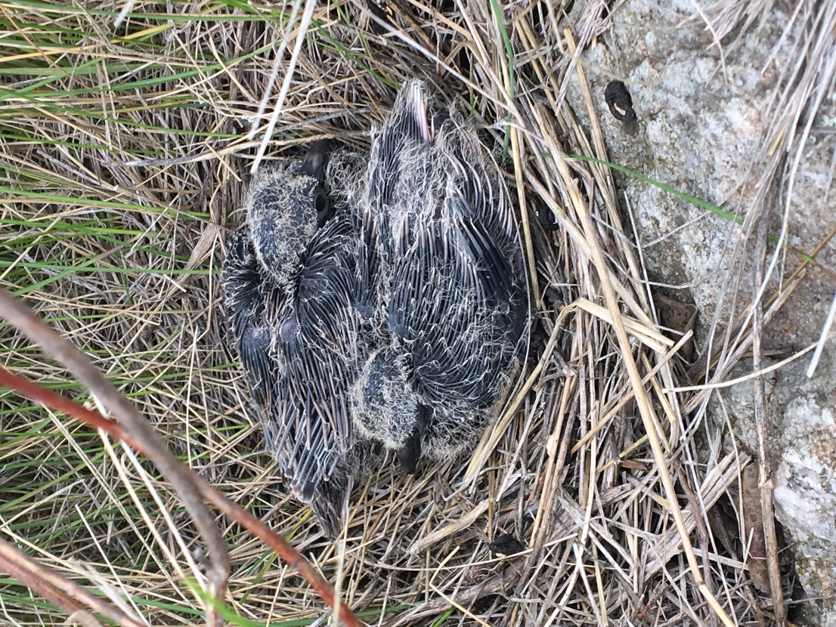

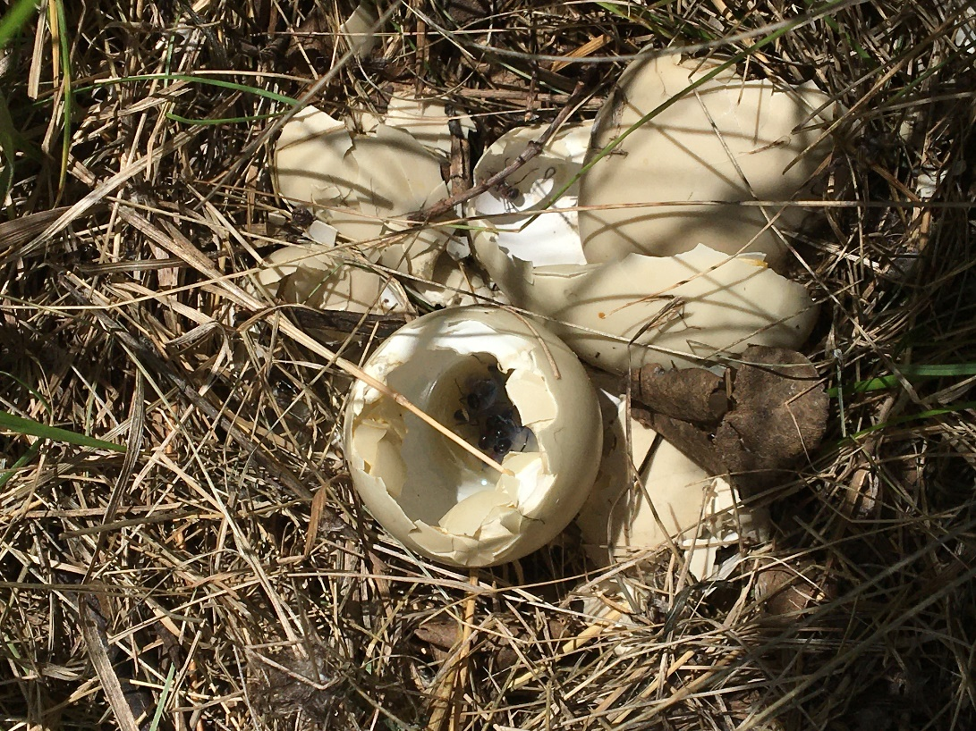
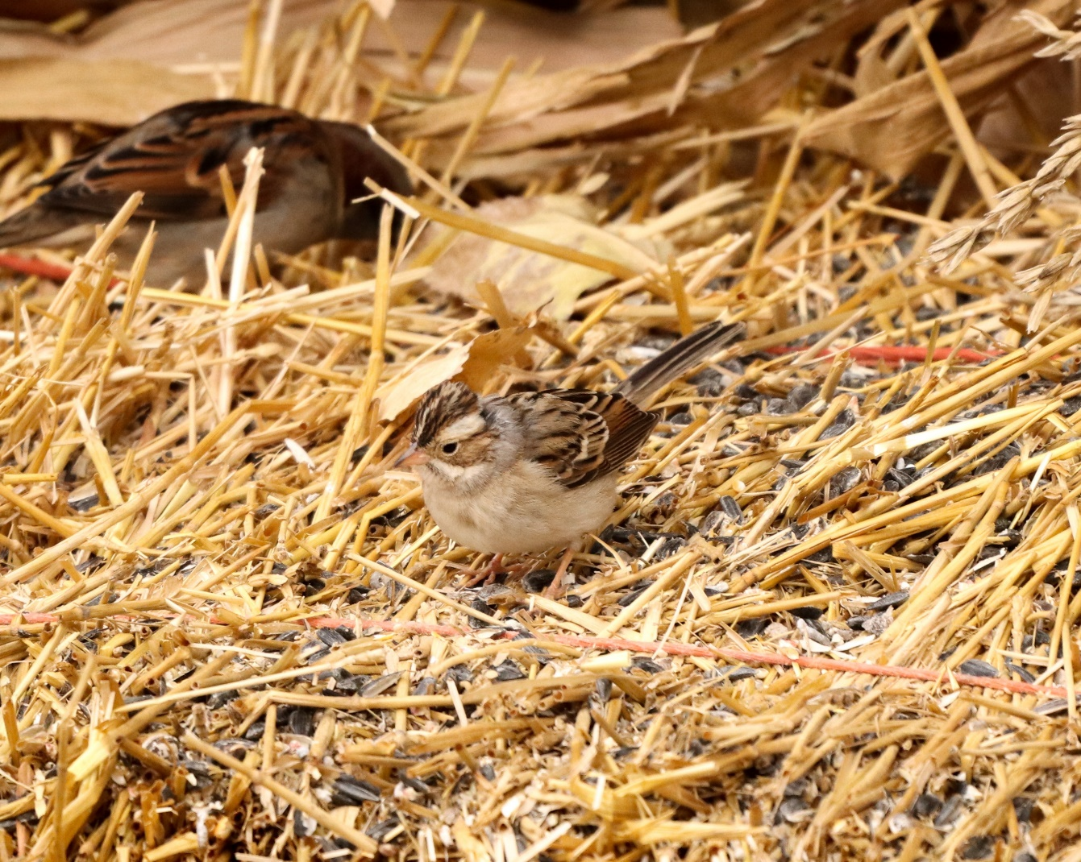
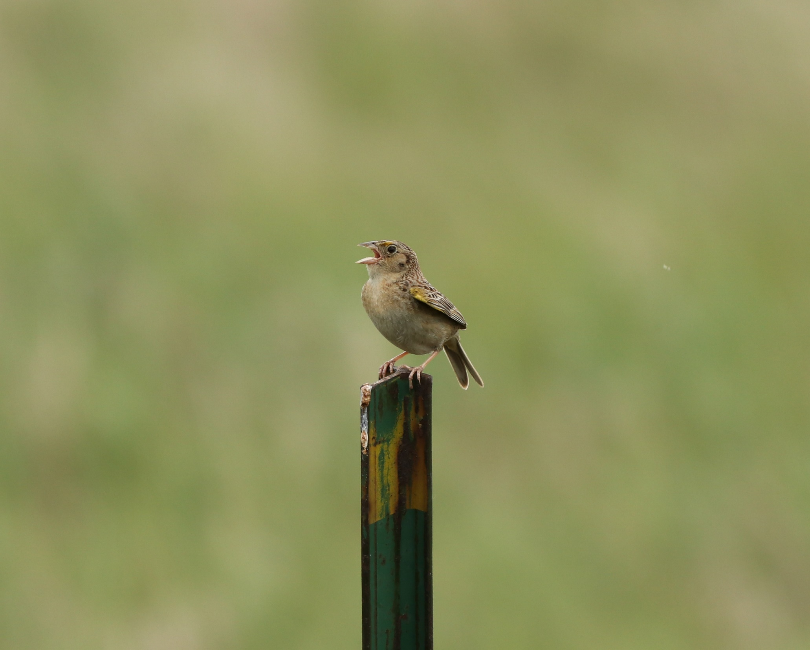
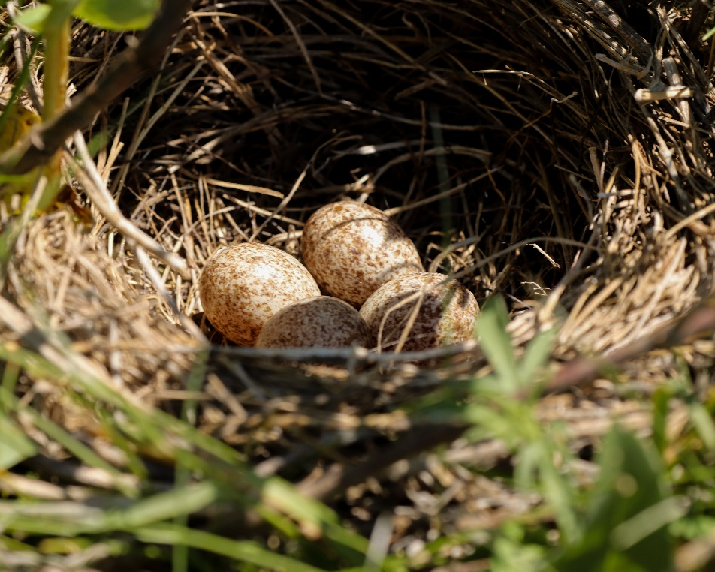
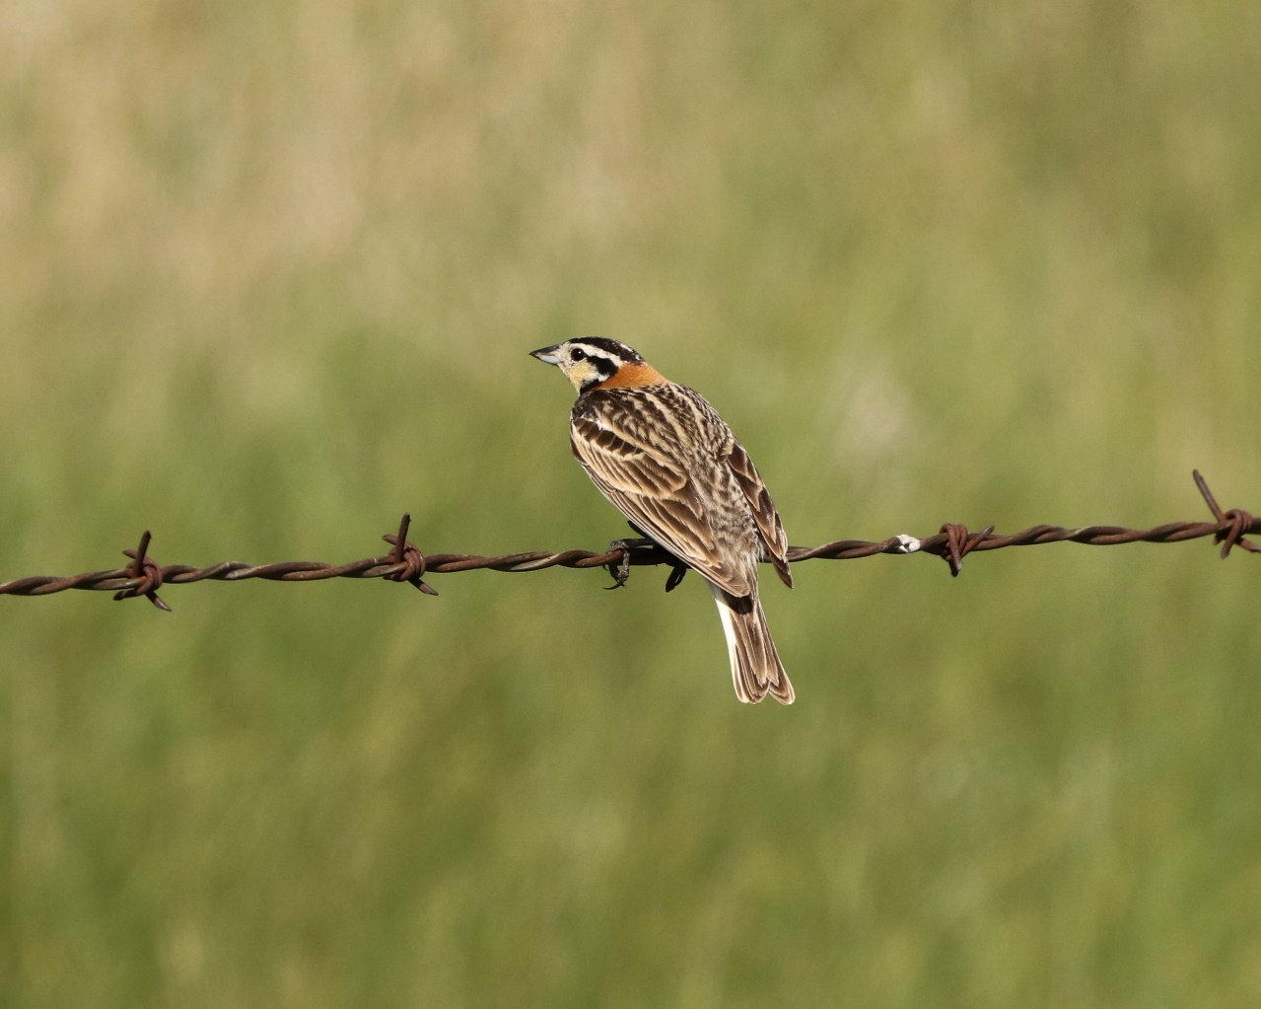


Breeding Bird Nesting Abundance and Nest Success in a Modified Twice-Over Rest-Rotation Grazing System
Justin Clarke¹, Torre Hovick¹, Kevin Sedivec^{1,2} , Ryan Limb¹, Jason Harmon¹, Ben Geaumont³
¹ School of Natural Resource Sciences, North Dakota State University, ² Central Grasslands Research Extension Center, ³ Hettinger Research Extension Center
BACKGROUND
Current grazing management in much of the Great Plains negatively influences avian diversity by creating homogenous landscapes through uniform grazing practices and altered or suppressed fire regimes.
Research has shown that restoring disturbance regimes can increase heterogeneity which increases avian biodiversity.
Fire and grazing interactions are effective at establishing heterogeneity, but many regions have a cultural aversion to fire which requires creative management practices to restore heterogeneity.
RESULTS
Vegetation Structure
Avian Nesting Abundances
Avian Nesting Community
A
AB
AB
B
Heavy
stress = 0.12
p-value = 0.06
FAC
Full
OBL
Moderate
Rest
RESEARCH QUESTIONS
Can varying degree of utilization within a pasture create a shifting mosaic of vegetation structure?
How does grazing intensity impact the avian nesting community?
A
BC
B
AC
METHODS
Modified Twice-Over Rest-Rotation Grazing System
Pastures are divided into four paddocks based on utilization.
Rested (21 months of no grazing, 0% utilization)
Moderate Intensity (20-40% utilization)
Full Intensity (40-60% utilization)
Heavy Intensity (60+% utilization)
Stocking rates were maintained at ~2.76 AUM/ha.
Vegetation Sampling
We measured vegetation structure along three 25 m
transects in each paddock.
We took visual obstruction readings (VOR) and litter depth measurements at 0, 12.5, and 25 m.
The number of facultative (FAC) and obligate (OBL) individuals nesting in each grazing intensity. Grouping is based on habitat preference.
Avian nesting communities between grazing intensities where closer points are more similar. Vegetation structural measurements are overlaid; longer arrows indicate factors that more strongly differentiates grazing intensities. Ellipses show 95% confidence intervals .
Group | Species | Nests
Facultative | 16 | 393
Obligate | 8 | 44
Total | 24 | 437
Grazing Intensity | Heavy | Full | Moderate | Rest
Proportion of Total Nests | 16% | 29% | 41% | 15%
Apparent Nesting Success | 22% | 26% | 30% | 26%
Visual obstruction reading (top) and litter depth measurements (bottom) for each grazing intensity. Letters indicate significant differences.
Number of avian species and nests divided into groups based on habitat preference.
The proportion of the total nests and apparent nesting success for combined species across each grazing intensity.
Nest Dragging
We conducted nest drags from late-May to mid-July covering each paddock 4 times.
We used a 30 m rope with aluminum cans tied every 5 m.
Nest Monitoring
We monitored nests every 2-4 days until fate was determined.
Successful nests fledged at least one conspecific individual.
IMPLICATIONS AND FUTURE OBJECTIVES
Variation in grazing intensity creates heterogeneity in vegetation structure, but these changes can be complex.
Avian nesting abundances are impacted by vegetation structure and seem to be driven by changes in litter depth.
These results are preliminary and based on data collected during a period of extreme drought.
Research will continue to examine the impacts of a modified twice-over rest-rotation grazing system on nesting success for three additional years.
Contact Information
justin.r.clarke@ndsu.edu
Scan the QR code for references and additional information

